Slide 1
Basic Biological Concepts
Ecology
Section 4 – Lecture 1

Slide 2
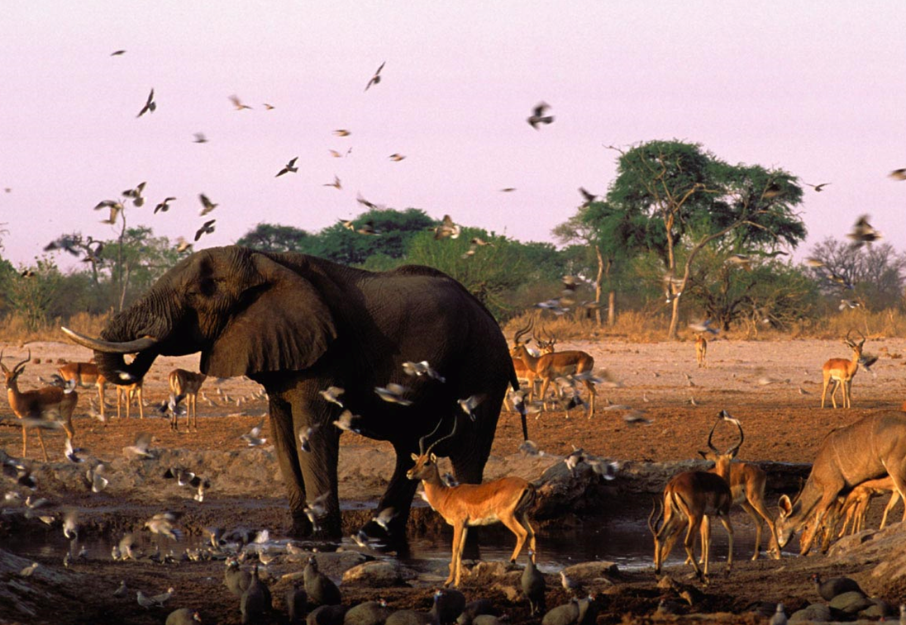
Ecology
Ecology is the study of the interactions that living things have with each other and their biophysical environment
Includes both biological and nonbiological components
Ecology is not environmentalism
Ecologists describe the natural world as it is rather than how they think it should be
Effective efforts to make
environmental change
require sound ecological
investigation, however.

Slide 3
Levels of Ecological Analysis
Individual Organisms and Species
The lifecycle and needs of individual organisms of a species
What does a squirrel need….
Populations
A population is all the members of a single species that live in a defined area
Examples: The squirrel population on the CSUS campus
3. Communities
A community is all of the populations that live in a defined area and interact with each other
Examples: The squirrel, bird, worm, tree (etc.) populations on campus
4. Ecosystems
An ecosystem is a community of organisms and the non-living physical environment in which they live
Non-living factors include wind, water, rocks, rain, soil, tides, etc.
Biosphere
The part of the planet with living organisms
Includes most of Earth, including part of the oceans and the atmosphere

Slide 4
The Tools of the Ecologist
1. Identifying the Ecological Niche
An ecological niche is the role and position a species has in its environment
How it meets its needs for food and shelter
How it survives
How it reproduces
A species' niche includes all of its interactions with the biotic and abiotic factors of its environment

Slide 5
The Tools of the Ecologist
2. Population Dynamics
For ecologists, it is valuable to know the size of a population and how it is changing
It is usually impossible or impractical to count each individual of a population so ecologist use estimates
Nearly all populations will grow at an exponential rate under ideal conditions
This is because the offspring added to the population can themselves produce offspring to add to the population

Slide 6
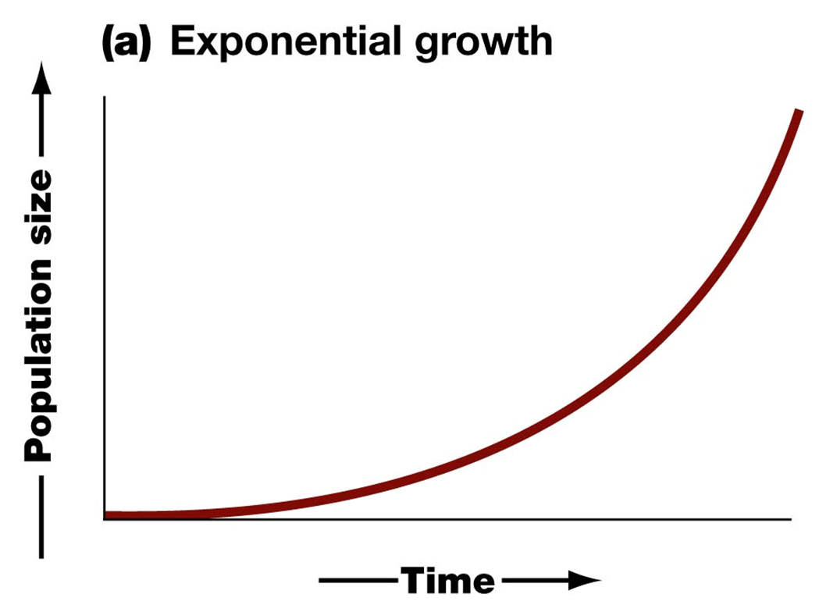
Exponential growth in a bacterial population…
In ideal conditions (moist, warm, nutrient-rich) bacteria can reproduce every 20 minutes
If initially there is only a single bacterium, then in 20 minutes there will be two bacteria.
The two bacteria will then divide again 20 minutes later to create four bacteria.
So after an hour there will be
sixteen bacteria.

Slide 7
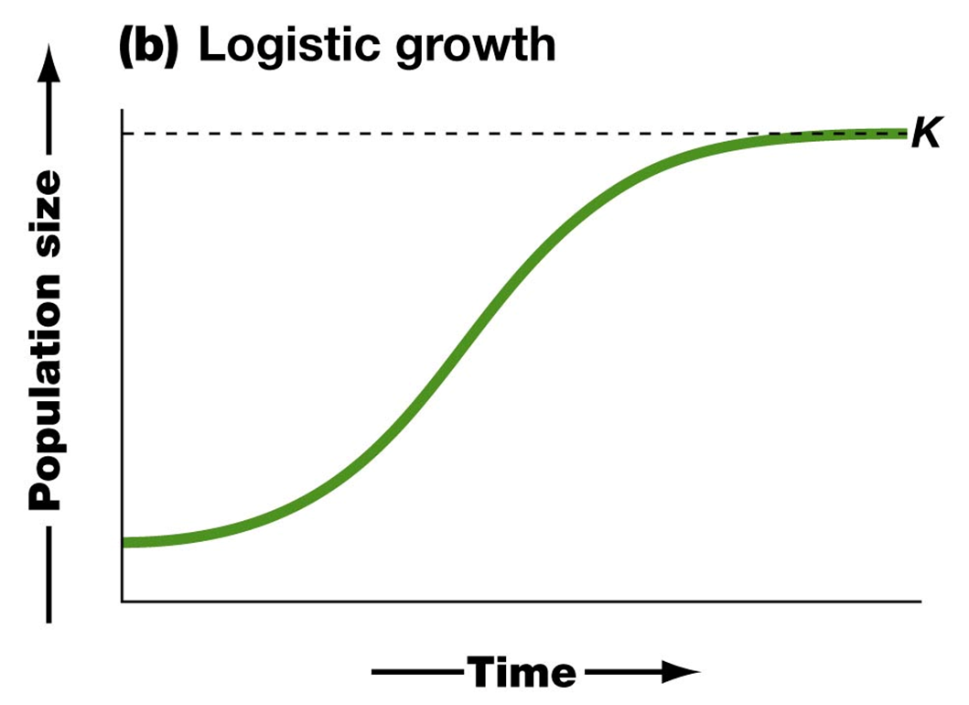
Logistic growth in a population…
Obviously, not all populations grow in ideal conditions
As a population’s size gets larger, factors tend to start limiting population growth – chiefly, limited resources
At some point the population size stabilizes (zero growth)
Logistic growth is exponential growth in a population that is capped by local environmental conditions

Slide 8
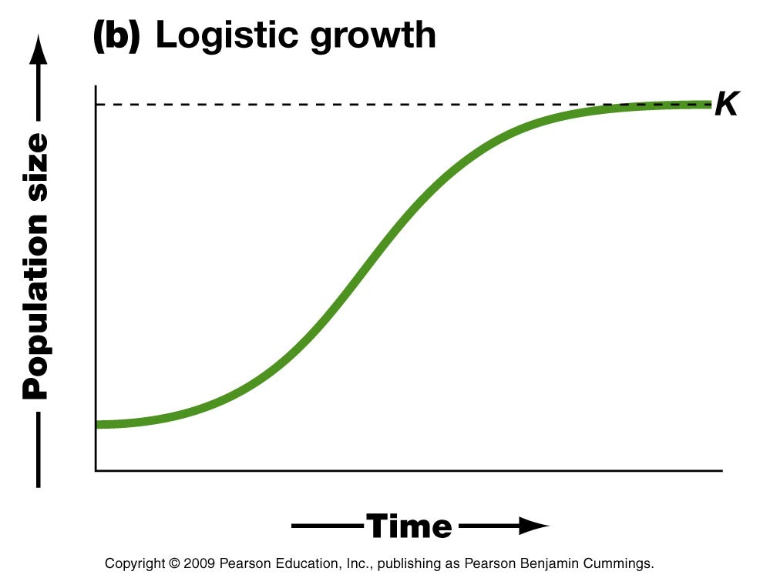
The maximum stable size a population can achieve is called its carrying capacity
A population size larger than the carrying capacity cannot be sustained for long
Carrying capacity

Slide 9
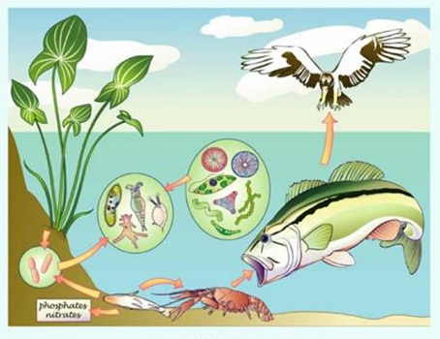
3. The Ecology of Communities
Few (if any) species can live without relying on other species
Species interact with each other in ways that benefit one, both, or neither
The four primary modes of interaction between species are:
Competition
Predation
Mutualism
Commensalism

Slide 10
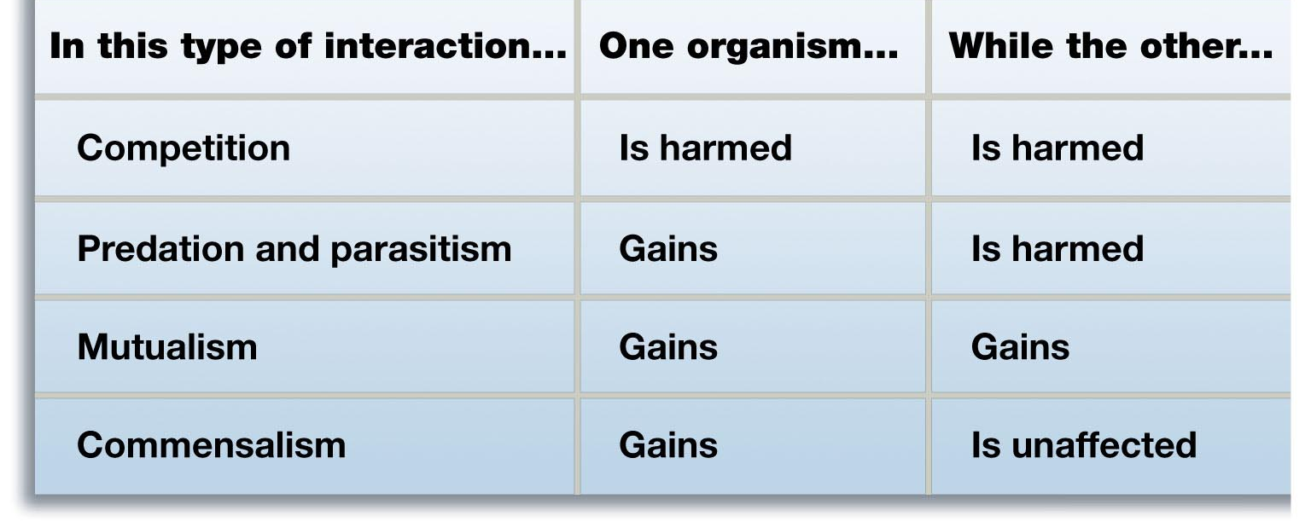
The Benefits Change to the Participants Based on the Type of Species Interaction

Slide 11
A. Competition
Competition for resources occurs when the ecological niches of two species overlap
If a resource is vital to two species, the competition for it will usually drive one species to local extinction
This phenomenon is known as the Competitive Exclusion Principle
Sometimes two species competing for a vital resources can both survive if they are able to divide up the resources
In Resource Partitioning, each species specializes in how it obtains the vital resource and does not exclude the other

Slide 12
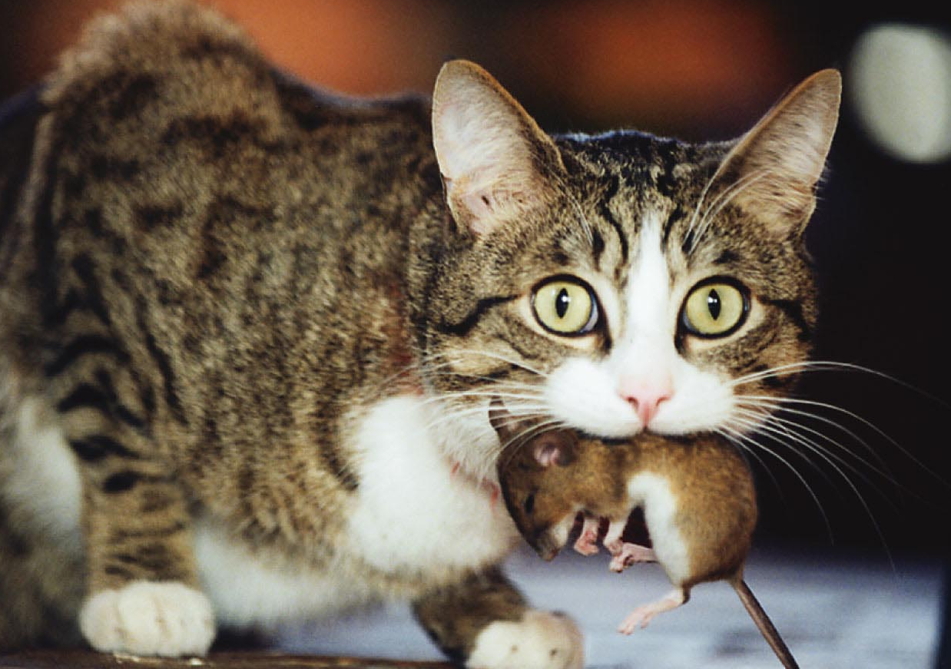
B. Predation
Predation is when one organism feeds on another organism
This includes the role of parasites on larger organisms

Slide 13
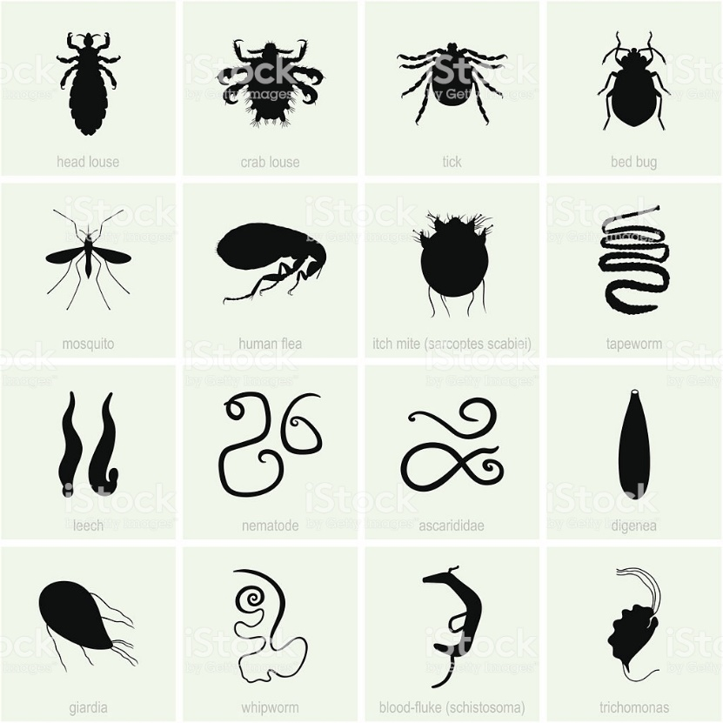
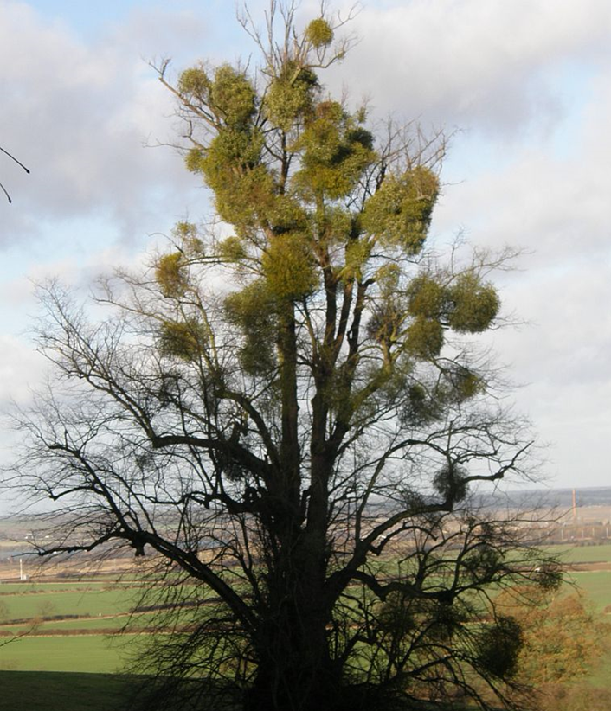
Parasitism is a variety of predation in which the predator feeds slowly and doesn’t kill the prey immediately
Humans have a variety of natural parasites
Mistletoe is a parasite of trees, sucking nutrients from them
Human Parasites
Mistletoe

Slide 14
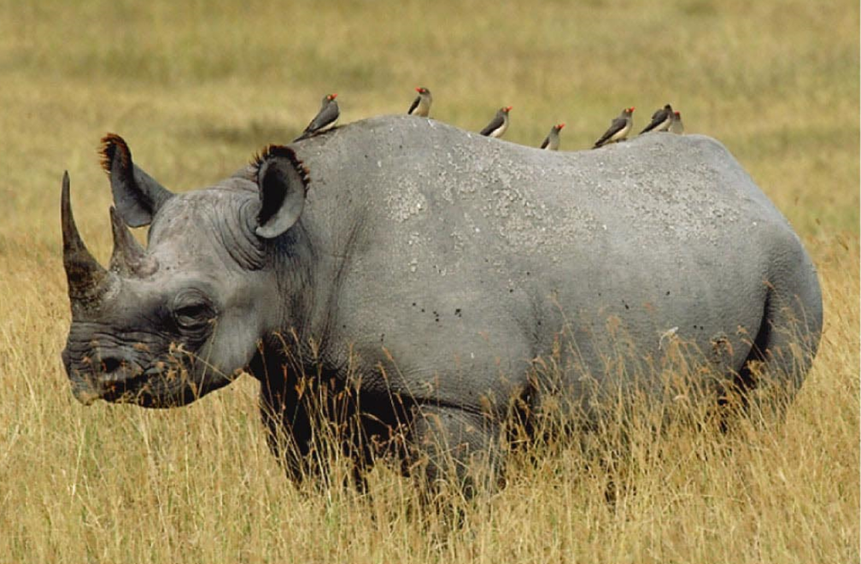
C. Mutualism
In mutualism, both species benefit from the interaction
Oxpecker birds sit atop a rhinoceros to eat any fleas and ticks on it. They get a meal and a safe habitat while the rhino gets cleaned of parasites

Slide 15
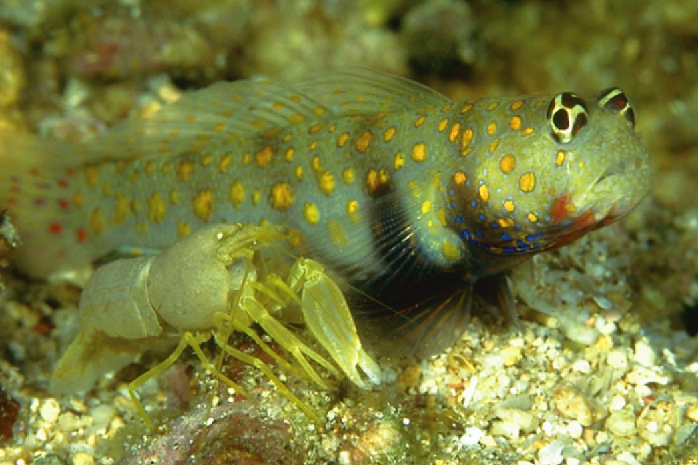
The spotted shrimp goby is a fish that shares a burrow with a snapping shrimp
The goby gets his home dug and cleaned for him while the snapping shrimp gets protection

Slide 16
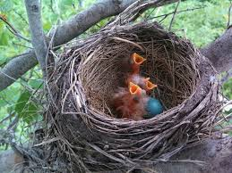
D. Commensalism
In commensalism, one species benefits while the other is neither harmed nor helped
Birds build nests in trees – the birds get a place to build their homes but the trees are generally unaffected

Slide 17
4/5. The Ecology of Ecosystems and the Biosphere
At these levels of Ecological Analysis, Biologists must team with experts from other fields, such as Chemistry, Geology, Physics, Oceanography, Atmospheric Science, Toxicology, and others….
How does water impact the Community?
How does the local geology impact the Community?
How do human encroachments impact the Community?
How do environmental toxins impact the Community?

Slide 18
Human Impacts on Earth’s Ecology
Humans have separated ourselves from the environment
We mistakenly believe that we are above our biology
However, we strongly impact all five levels of ecology
We compete for resources, often taking everything
We are apex predators (Agent Smith says we’re parasites)
Some people have made efforts to reclaim our participation
We should at least strive for commensalism, at best for mutualism
However, overall the impact of humans is very negative
We are rapidly approaching a point of unsustainability

Slide 19
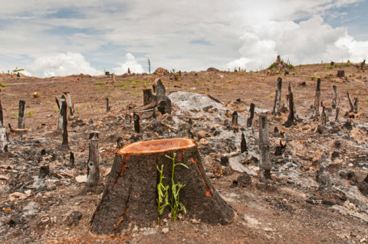
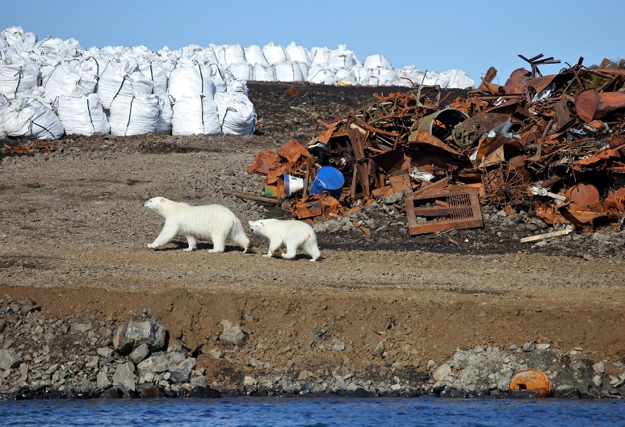
What current issues need ecological investigation to solve?
The causes, impacts and solutions to disruptive human activity
Overpopulation and urban sprawl
Natural resource depletion
Deforestation
Pollution and waste disposal
Introduction of invasive species
Known impacts of human activity
Global warming & climate change
Loss of biodiversity
Human health issues

Slide 20
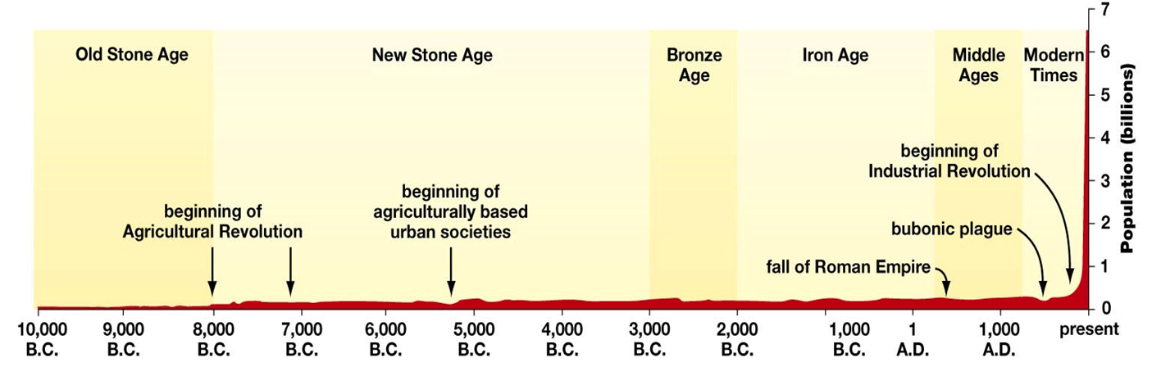
Human Population Dynamics
Currently there are about 7.7 billion humans on the Earth http://www.worldometers.info/world-population/
Globally, the human population has been undergoing exponential growth
Estimates suggest that the growth rate is finally slowing

Slide 21
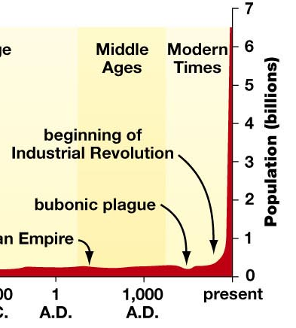
So, what caused the huge increase in the human population?
One factor that affects the growth of a population is how many children are born to each female
This is known as the total fertility rate

Slide 22
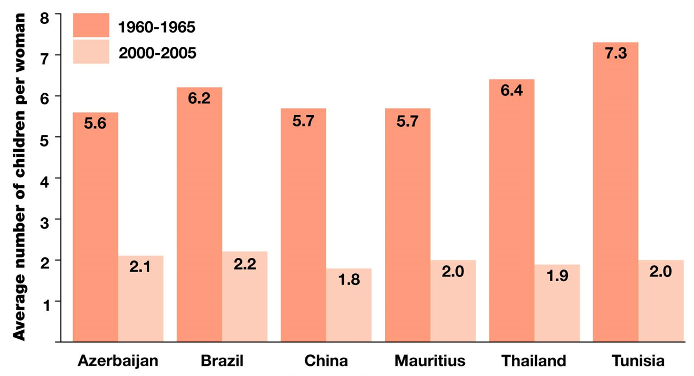
Fertility Rate and the Slowing of the Human Growth Rate
In humans, an average of 2.1 children per female results in a zero population growth
Total fertility rates larger than 2.1 result in an increase in population growth (and vice versa)
Many countries with formerly high rates have declined to zero growth or less in the 2000’s
Why 2.1 (and not 2.0)?
Not all children will be able to have children of their own

Slide 23
Migration Effects
The size of a population is dependent on four factors:
Birth rate
Death rate
Immigration – entering an area
Emigration – leaving an area
The population of the U.S. is increasing even though the death rate exceeds the birth rate
The reason for this is because the immigration rate is so high…
immigration + birth > emigration + death

Slide 24
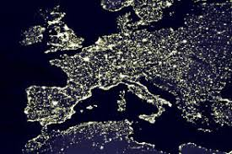
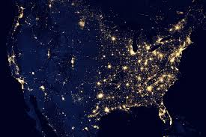
Urban Sprawl
Urban sprawl is unrestricted, unplanned growth of cities, towns
Housing, commercial development and roads
Covering open land and impacting ecological communities, etc.
Habitation Fragmentation separates genetic contributors
Lights of Europe
Lights of the United States

Slide 25
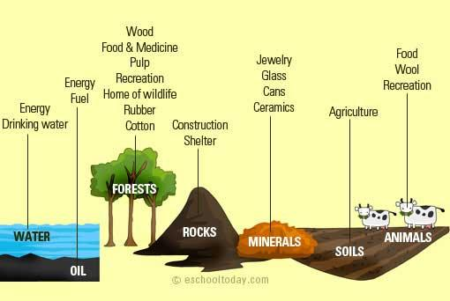
Depletion of Natural Resources
Occurs when resources are consumed faster than replaced.
Resources that are in existence without human’s actions.
They can either be renewable or non-renewable.
Natural resources include:
Air
Water
Fertile land
Forests
Fossil fuels
Fish and wildlife
Mining products

Slide 26
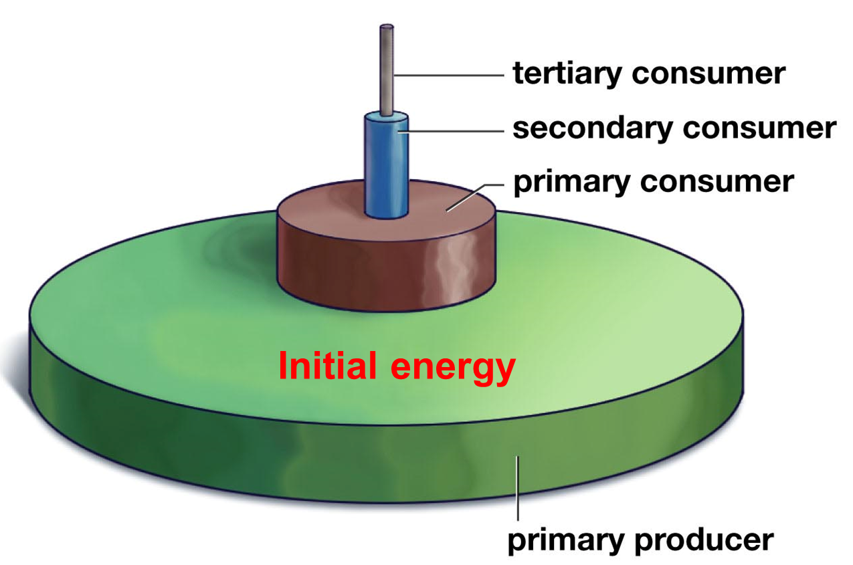
Energy from Food Consumption
When an organism is eaten, only about 10% of its energy is passed on to the organism that ate it
As nutrients flow up the trophic levels about 90% of the original energy is lost at each trophic level

Slide 27
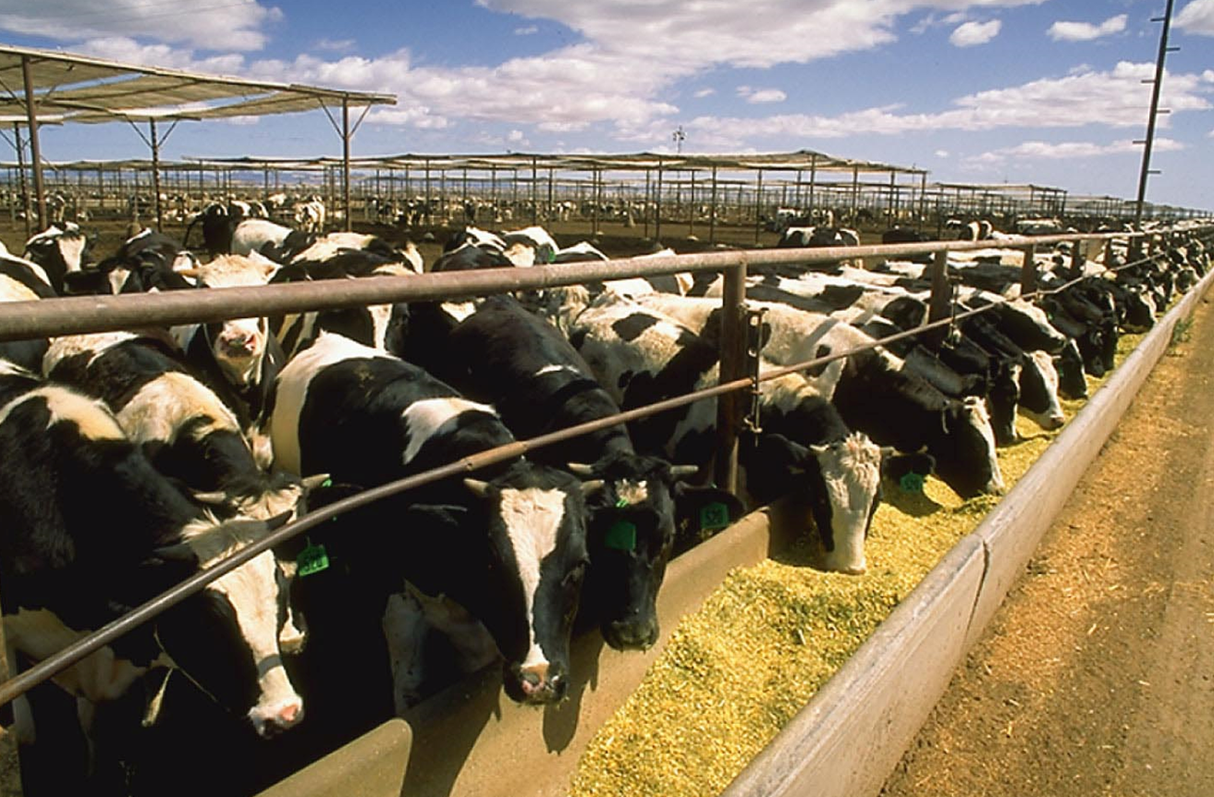
Why can an acre of corn feed more humans than if the corn was first fed to cows, and then the humans ate the cows?
10% of the corn energy is available to humans if they eat the corn directly
Only 1% of the corn energy is available to humans if they eat the cows after the cows ate the corn

Slide 28
Deforestation
Deforestation is the removal of a forest or stand of trees from land which is then converted to a non-forest use.
Farms, ranches, or urban use.
Major ecological impacts include:
Soil erosion destruction. Soils (and the nutrients in them) are exposed to the sun's heat.
Water Cycle. When forests are destroyed, the atmosphere, water bodies, and the water table are all affected.
Loss of Biodiversity.
Climate Change.
The most concentrated deforestation occurs in tropical rainforests.

Slide 29
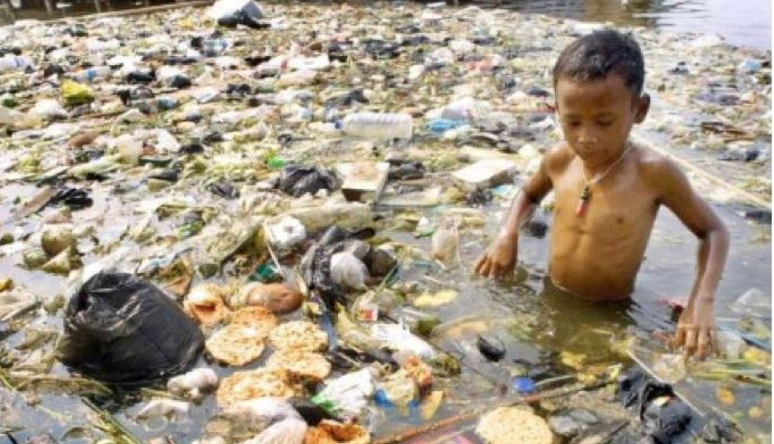
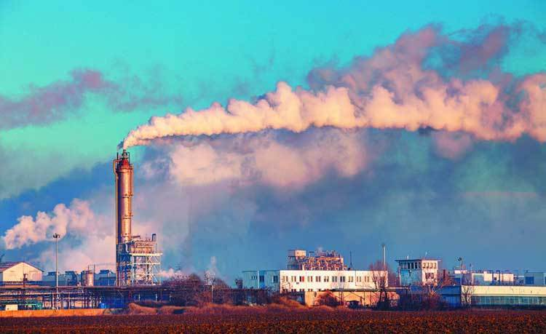
Pollution and Waste Disposal
Pollution is the introduction of contaminants into the natural environment that cause adverse ecological change.
Pollution can take the form of chemical substances or energy, such as noise, heat or light.
Pollutants can be either foreign substances/energies or naturally occurring contaminants

Slide 30
Introduction of Invasive Species
An invasive species is not native to an ecosystem and causes harm.
Species that grow and reproduce quickly, and spread aggressively, with potential to cause harm, are given the label “invasive.”
They can harm the environment, the economy, or even human health.
Invasive species are among the leading threats to native wildlife.
Approximately 42 percent of threatened or endangered species are at risk due to invasive species.

Slide 31
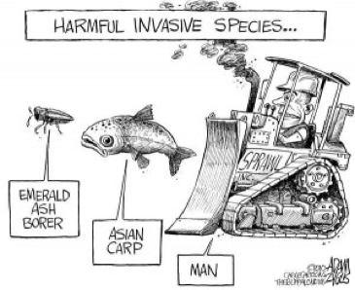
Notable examples of invasive plant species include the kudzu vine, Andean pampas grass, and yellow starthistle.
Animal examples include the New Zealand mud snail, feral pigs, European rabbits, grey squirrels, domestic cats, carp and ferrets.
And, of course, us!

Slide 32
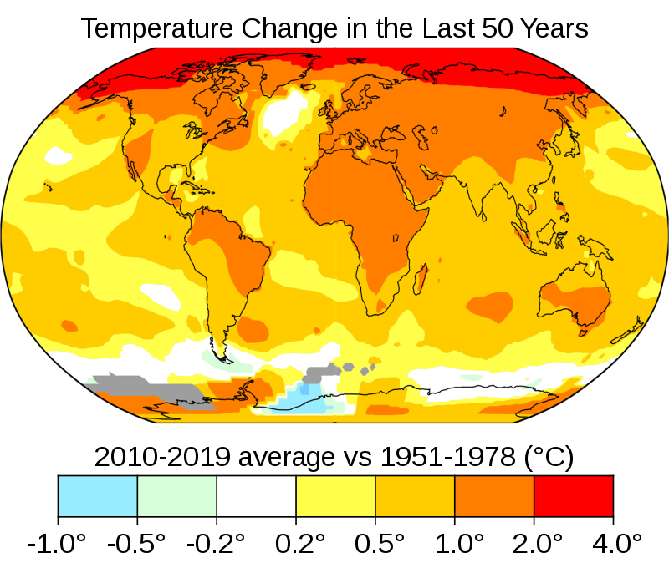
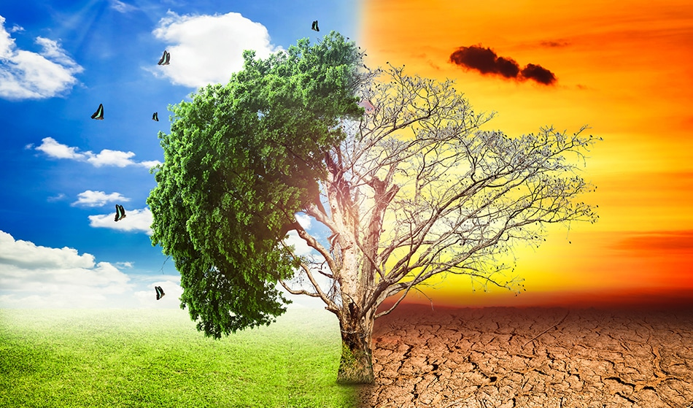
Global Warming and Climate Change
Global warming is the ongoing rise of the average temperature of the Earth's climate system
It has been demonstrated by direct temperature measurements and by measurements of various effects of the warming.
It is a major aspect of climate change which, in addition to rising global surface temperatures, also includes its effects, such as changes in precipitation.
There have been prehistoric periods of global warming, but observed changes since the mid-20th century have been unprecedented in rate and scale

Slide 33
Loss of Biodiversity
Biodiversity loss is the extinction of species worldwide
Also, local reduction or loss of species in a certain habitat.
The five major causes:
Climate change.
Deforestation and habitat loss.
Overexploitation and overharvesting.
Invasive species.
Pollution.
The alarming trends have led some to declare the current period the "Sixth Great Extinction."
Estimates that up to 30% of all species will be extinct by 2050.
Others have estimated that as many as 140,000 species are lost each year.

Slide 34
Major Problems Associated with Loss of Biodiversity
Economic Costs: “Ecosystem Services” such as pollination, irrigation, soil reclamation, fertilization performed naturally
Humans must perform them if key species are lost
Deforestation alone estimated to cost $2-5 trillion annually
Loss of species disrupts industries and livlihoods, such as: farming, fishing, forestry, etc.
Reduced Food Security: fewer food species means less genetic protection against disease, drought and climate changes
Increased Exposure to Disease: disease carrying organisms (rats, mosquitos, etc.) adapt more readily to habitat fragmentation
More Unpredictable Weather: The Biosphere is interdependent with the atmosphere and hydrosphere.

Slide 35
Human Health Issues
Nutrition: adequate nutrition depends on eating a variety of foods to get a variety of nutrients. Too consistent a diet is often associated with nutritional deficiency.
Disease: Major processes affecting infectious disease reservoirs and transmission include:
Deforestation
land-use change
water management and irrigation
uncontrolled urbanization or urban sprawl
resistance to pesticide chemicals used to control disease vectors
climate variability and change
migration and international travel and trade
accidental or intentional human introduction of pathogens
Environmental Toxicity: The introduction of chemical and other pollutants into the environment affects humans as well as other species negatively
Health Research and Medicine: Many medicines are based on natural molecules and new medicines are dependent on a large variety of sources for experimentation and extraction.

